Slide 1
BORO Analysis Tools
C-FORS Summer School in Foundational Ontology (C-FORS 2025)
23 May 2025, University of Oslo, Norway
Chris Partridge Andrew Mitchell Oscar Xiberta Soto Diego Alberto Zabala Betancur Jonathan Eyre

Slide 2
Schedule
Morning Sessions
 | 9:00 - 9:05 | Session 0 – Introduction
 | 9:05 - 9:45 | Session 1 – Context
 | 10:00 - 10:45 | Session 2 – BORO Ontology
 | 11:00 - 12:00 | Session 3 – Analysis Tools
Afternoon Sessions
 | 1:15 - 3:30 | Session 1 – Practical Examples
 | 3:30 - 5:00 | Session 2 – Examples Discussion / Presentation

Slide 3
Structure
Overview
LOAD: Structured Data Table Migration
BORO Top Level Tables
EVOLVE
Support Tools
Space Time Maps
Ontological Euler Diagrams
BORO UML
BORO eXcel Table (Manual) Pipeline
BORO KNIME Data Pipeline
Project planning

Slide 4
Overview

Slide 5
Overall goal
To provide some ‘practice’ with ontologization interoperability pipelines
by recreating the first stage of an ontologization interoperability pipeline
With (simple) examples
directly experience some of the challenges (in an attenuated form)
Probably significantly more ‘practice’ needed before one becomes expert

Slide 6
Two practical problems
Practical problems
lump of clay
ISO Countries
The focus this afternoon will be on the first problem. If you manage to finish the first problem, the second problem is available.

Slide 7
Six BORO Summer School tools
Abbreviation | Name | Stage
SDTM | Structured Data Table Migration | LOAD
STM | Space Time Maps | EVOLVE
OED | Ontological Euler Diagrams | EVOLVE
BUML | BORO UML | EVOLVE
BXTP | BORO eXcel Table (Manual) Pipeline | EVOLVE
BKnDP | BORO KNIME Data Pipeline | EVOLVE
NB: This is a list developed for the Summer School. There is a large range of evolving tools, which we have selected from.
Note also, our default language/tool is Python not KNIME. KNIME has been selected for its no-code credentials – making it more appropriate here.

Slide 8
LOAD: Structured Data Table Migration

Slide 9
Principle: shift (data) structure left
A goal of the bCLEARer pipeline process is to shift left, as far a possible, the move to structured data
enable us to work with machines talking to machines as soon as possible
If one starts with unstructured text
one needs to structure it
with the minimum intervention
preserving as much of the explicit structure as possible
A good first step is a shift to simple tables
the simplicity of their structure helps to keep the structuring clear
One goal of Load is to ensure one is working with structured data

Slide 10

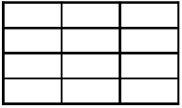

Structured data table migration
SDT
unstructured text
structured data table

Slide 11
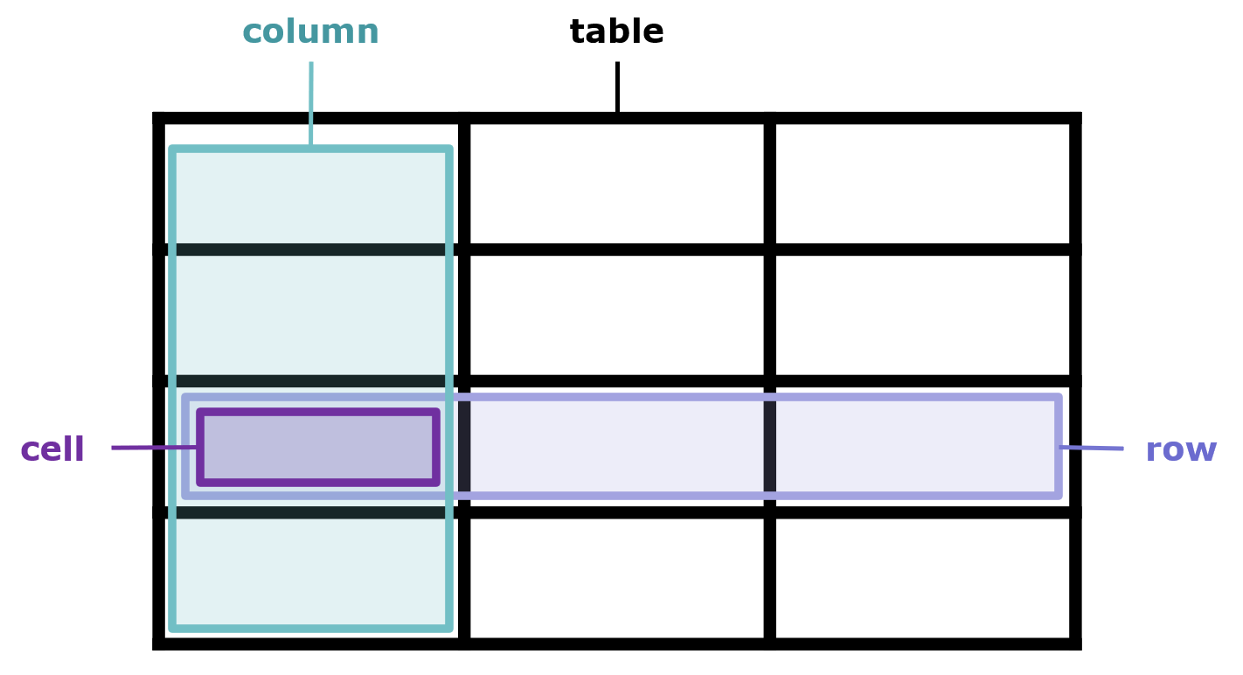
Base data table structure

Slide 12

Base table composition structure
base table composition structure
data type | structure type | table structure element | description
data item | table | row | composed of cells organised by column
data column | table | column | composed of cells organised by row - has a single column heading cell.
data cell | table | cell | the intersection of columns and rows - has content

Slide 13
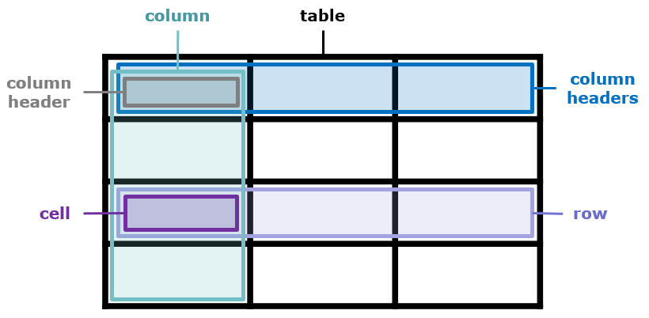
Extended data table structure

Slide 14
Lump of clay - starting point
We start with unstructured text:
“There is a lump of clay that, at time t1, is used to make an aesthetically valuable statue. At time t2, the statue is destroyed. At time t3, the same lump of clay is reshaped to make a different statue. This statue is aesthetically valuable too.”
NOTE: We do this here
and provide you with the results for the practical example.

Slide 15
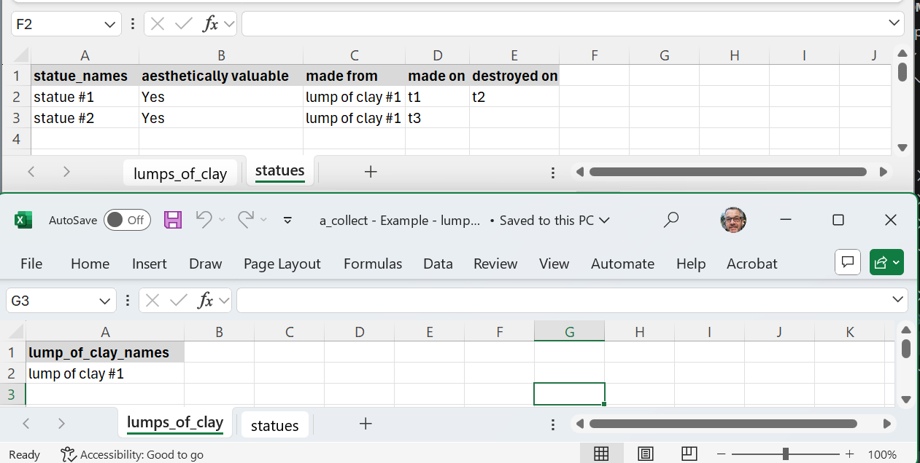
Lump of clay – migration to table 1
“There is a lump of clay that, at time t1, is used to make an aesthetically valuable statue.
At time t2,
the statue is destroyed.
At time t3,
the same lump of clay is reshaped to make a
different statue.
This statue is aesthetically valuable too.”

Slide 16
Lump of clay – migration to table 2
“There is a lump of clay that, at time t1, is used to make an aesthetically valuable statue.
At time t2,
the statue is destroyed.
At time t3,
the same lump of clay is reshaped to make a
different statue.
This statue is aesthetically valuable too.”

Slide 17
Lump of clay – migration to table 3
“There is a lump of clay that, at time t1, is used to make an aesthetically valuable statue.
At time t2,
the statue is destroyed.
At time t3,
the same lump of clay is reshaped to make a
different statue.
This statue is aesthetically valuable too.”

Slide 18
Lump of clay – migration to table 4
“There is a lump of clay that, at time t1, is used to make an aesthetically valuable statue.
At time t2,
the statue is destroyed.
At time t3,
the same lump of clay is reshaped to make a
different statue.
This statue is aesthetically valuable too.”

Slide 19
Lump of clay - structured data tables – proto time
not typical time data
a_collect - Example - lump of clay - stage 1 - proto time.xlsx

Slide 20
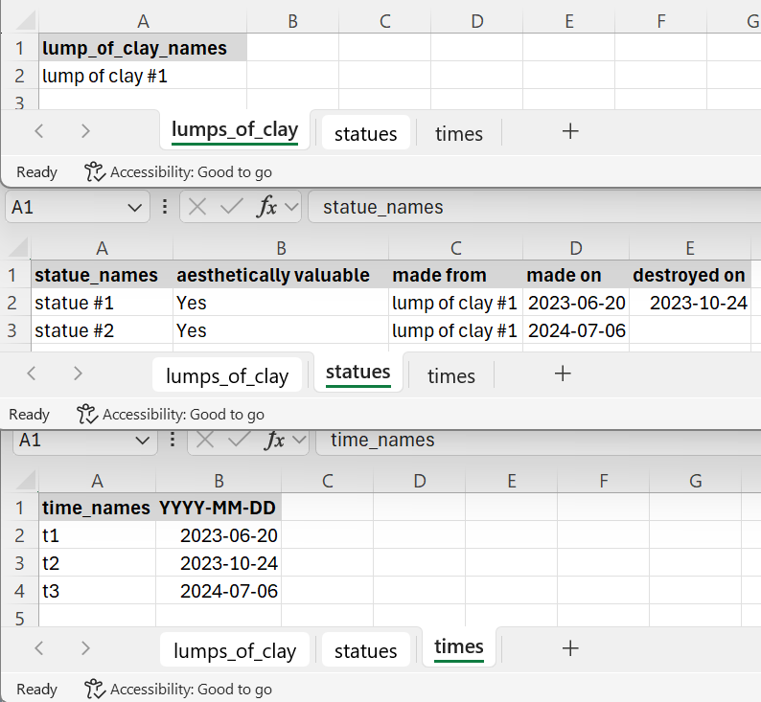
Lump of clay - structured data tables – dataise time
a_collect - Example - lump of clay - stage 1 - proto time.xlsx
NB: added domain knowledge about time granularity
a_collect - Example - lump of clay - stage 2 - dataise time.xlsx

Slide 21
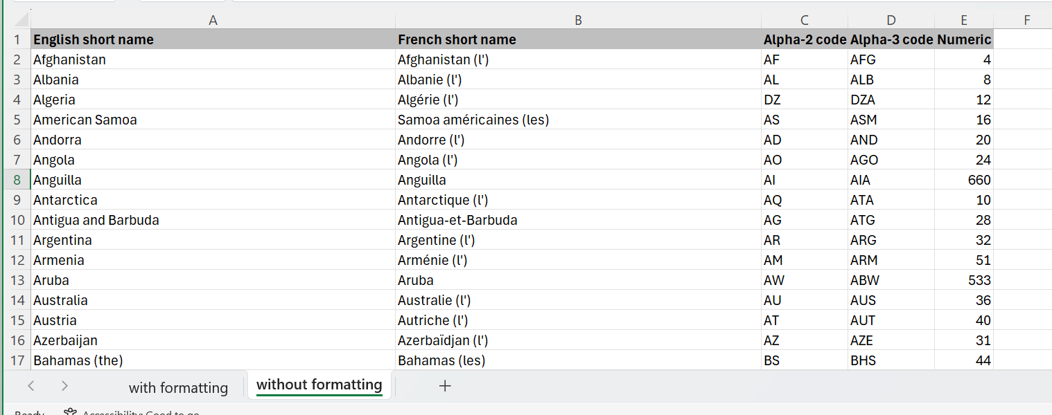
ISO Countries
Already structured data (table)
a_collect - Example - ISO 3166 - Part 1 -- Country code.xlsx

Slide 22
BORO Top Level Tables
LOAD: Structured Data Table Migration

Slide 23
BORO top level tables
The top level needs to be introduced to the pipeline
Various ways of doing this
Here, we add it in directly at LOAD
this is done for you in the starter pack
We add a simplified table version
suitable for the worked examples

Slide 24
BORO top level tables - pure
table_names | column_1_names | column_2_names | column_3_names | column_4_names
Sets | bie_ids | names
Individuals | bie_ids | names
Tuples | bie_ids
elements-sets | bie_ids | element_bie_ids | set_bie_ids
parts-wholes | bie_ids | part_bie_ids | whole_bie_ids
sub-super-sets | bie_ids | sub_set_bie_ids | super_set_bie_ids
tuple-places | bie_ids | placing_bie_ids | placed_bie_ids | place_numbers

Slide 25
BORO top level tables - pragmatic
table_names | column_1_names | column_2_names | column_3_names | column_4_names
Sets | bie_ids | names
Individuals | bie_ids | names
Tuples | bie_ids | place1_bie_ids | place2_bie_ids | place3_bie_ids
grounding-relation-places | bie_ids | relation-place-type_names | placing_bie_ids | placed_bie_ids
elements-sets | bie_ids | element_bie_ids | set_bie_ids
parts-wholes | bie_ids | part_bie_ids | whole_bie_ids
sub-super-sets | bie_ids | sub_set_bie_ids | super_set_bie_ids

Slide 26
EVOLVE

Slide 27
Broad outline
Same process stages for both practical problems
Broadly,
there is
a support process that ‘designs’ the pipeline
this has human aspects
a primary process that IS the pipeline
this is a ‘pure’ machine process
the process is executable, repeatable and inspectable
Hopefully,
building the primary process will help you experience the practice on ontologising a pipeline

Slide 28

EVOLVE - practical problem process
roundtrip check
LOAD
EVOLVE
primary process
SDT
BKnDP
support tools
TOP BUML
STM
The Excel Pipeline is used to inform the primary process
OED
BUML
BXTP
The support tools ‘support’ the primary process

Slide 29
Support Tools

Slide 30
Four BORO Summer School support tools
Abbreviation | Name
STM | Space Time Maps
OED | Ontological Euler Diagrams
BUML | BORO UML
BXTP | BORO eXcel Table (Manual) Pipeline
These Summer School ‘tools’ are part of a much wider, richer toolkit
They are useful pedagogical devices
As often, with practices, once one gains competence with these, one deploys them in innovative radically different ways

Slide 31
Space Time Maps

Slide 32
Practical problem process
LOAD
EVOLVE
SDT
STM

Slide 33
STM Segment
STMs Focus on Individuals
other BORO objects are constructed from (grounded in) Individuals
STMs are an intuitive way of visualising the mereology of Individuals
in particular the overlap and part hood relations
As Individuals (in BORO) have a mereological extensional criteria of identity
the ‘extensional’ two-dimensional surface of a page (or screen) has sufficiently similar characteristics to represent ‘directly’ (visually) the mereology
humans find this a useful tool

Slide 34
Purpose of STMs
STMs are typically used as a first stage of analysis, where in the second stage these are translated into a BORO model
STMs provide an easy way to visualise 4D elements in a domain
and as such are a useful way to start understanding them
The STM visualisation aims to abstract the individuals to their mereological essentials
Too time consuming to draw for the whole domain
so, collect representative examples of important ‘typical’ mereological relations
these are candidates for STMs

Slide 35
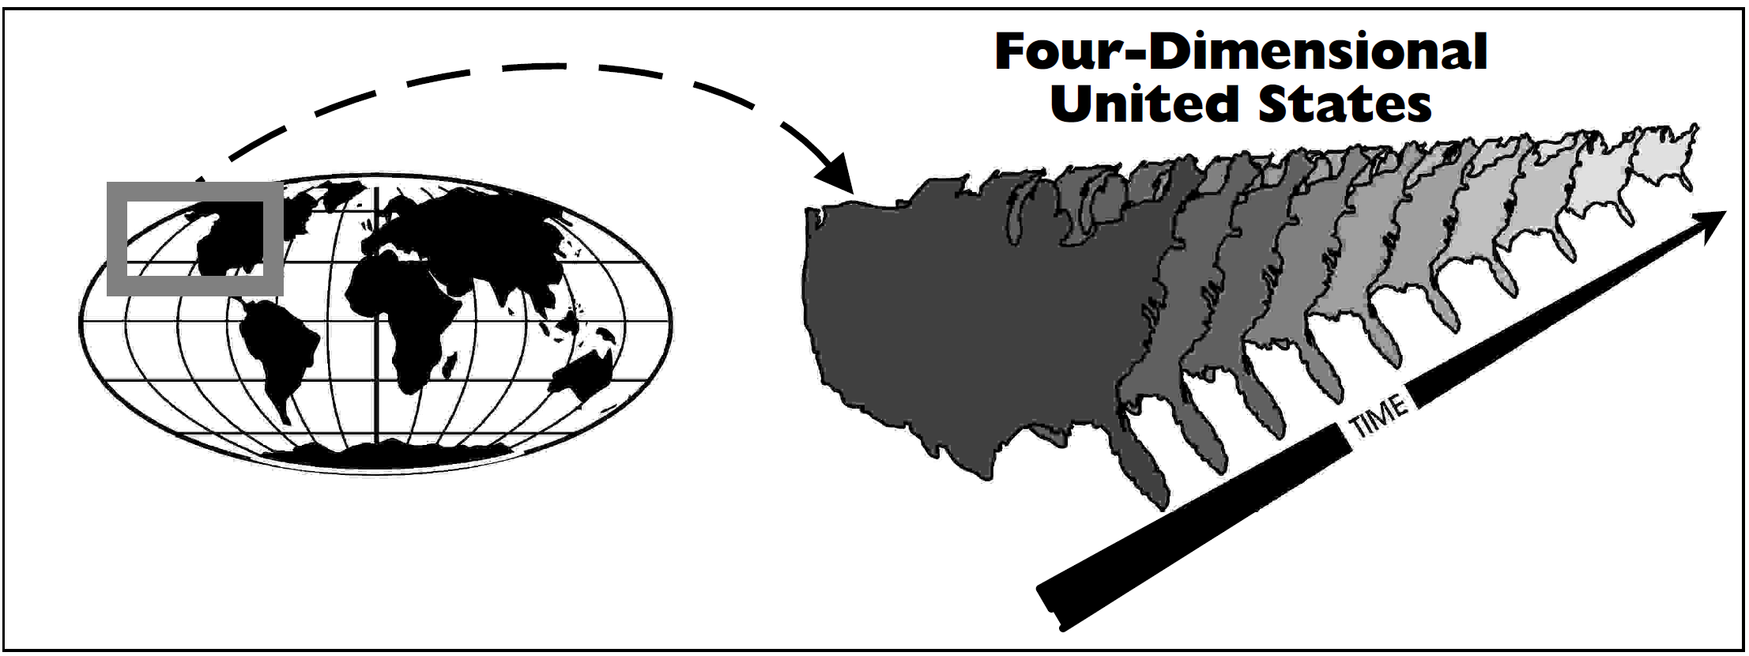
Individuals in BORO
BORO is an extensional ontology
the criterion of identity for Individuals is mereological (spatio-temporal) extension
or more colloquially four-dimensional (4D)

Slide 36
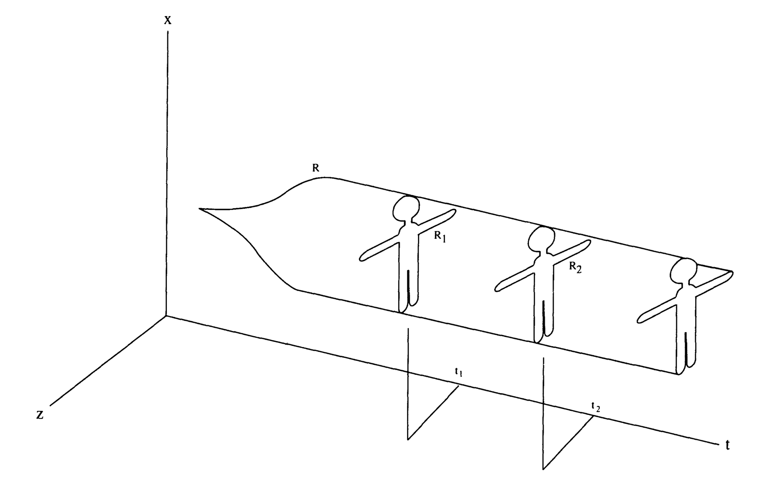
Van Inwagen’s space-time diagrams
Not that usual, but STMs appear in various places.
In this case, not quite the same, less focus on exact mereology.
Van Inwagen, P. (1990). Four-Dimensional Objects. Noûs, 24(2), 245.

Slide 37
Three components of an STM Individual
A region representing a spatio-temporal extent
A border around the region – the contour – marking the region as representing an Individual
A string of letters labelling the Individual
A
A

Slide 38
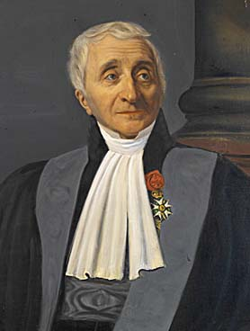
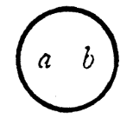
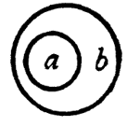
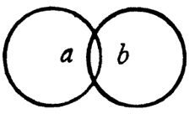
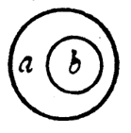
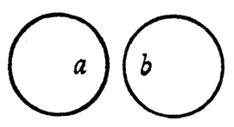

The Gergonne five possible extensional relations
The Gergonne relations give the five possible ways in which two objects can simply share extension
coincident | contained | overlap | contains | disjoint
“if and only if every a is a b and every b is an a” | “if and only if every a is a b and not every b is an a” | “if and only if it is not the case that either every a is a b or every b is an a or no a is a b” | “if and only if every b is an a and not every a is a b” | “if and only if no a is a b”
Based upon: J. A. Faris - The Gergonne Relations - The Journal of Symbolic Logic, Vol. 20, No. 3 (Sep., 1955), pp. 207-231
based upon: J. D. Gergonne, Essai de dialectique rationelle, Annales des mathematiques pures et appliquees, Vol. 7, (1817).

Slide 39
How to recognise STMs
Clues to look for
space axis along the left side of the page
time axis across the bottom of the page
reference frame contained within the axes
Individual rectangles (shapes) in the reference frame

Slide 40
Lore ipsum
Has space arrow up the page
Individual #1
SPACE
Individual #2
Has an STM reference frame
Has STM Rectangles in the reference frame
Has time arrow up the page
TIME

Slide 41
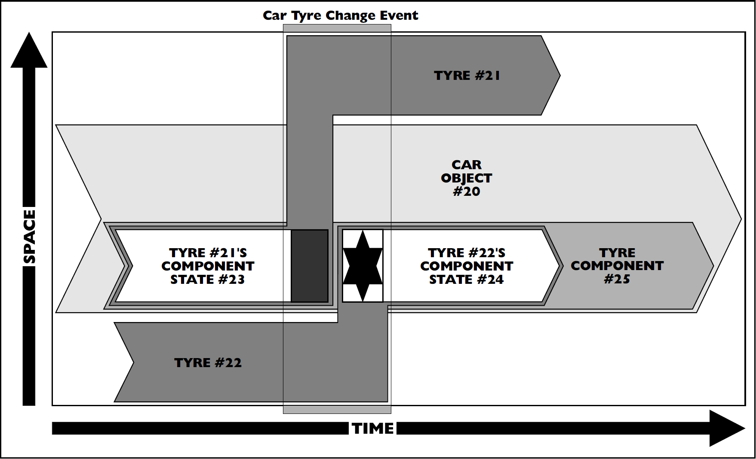
Patterns: overlap
Figure 8.14:
Car tyre change space-time map
From Business Objects: Re-engineering for Reuse

Slide 42
How to read STMs
The 2D reference frame picks out the relevant fragment of the 4D domain
The domain’s objects are shown as boxes
a box’s boundary represents the Individual’s real boundary
boxes’ containment, overlap, etc. show the mereological relationships between Individuals
a box’s name helps to further identify the Individual

Slide 43
Ontological Euler Diagrams

Slide 44
Practical problem process
LOAD
EVOLVE
SDT
OED

Slide 45
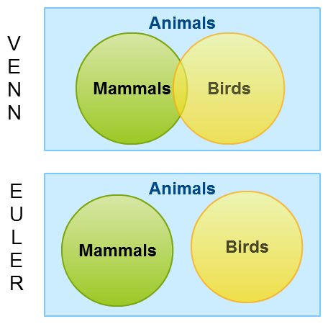
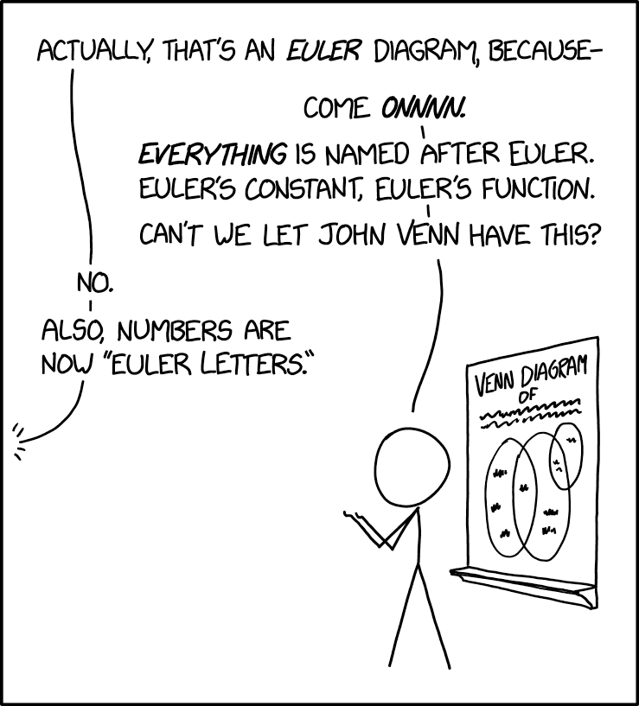
Euler not Venn diagrams
A Venn diagrams show all combinations (even impossible ones).
https://xkcd.com/2721/

Slide 46
Types in a BORO foundational ontology
Sets’ identity relations
from an ontological perspective, these will exist simpliciter
from an epistemic perspective, we may or may not know whether these exist
an ontological picture should not contain epistemological elements
to handle this issue, for the topic of the Euler diagram
we make a set identity relation omniscience assumption
in other words, all the identity relations between sets are known
With this assumption, it makes sense to adopt
the ‘Existential Import Convention’
where adding a region to the Euler diagram implies that it exists
in other words, it has members

Slide 47
Sets in a BORO foundational ontology
In BOROs’ extensional ontology
given a Set’s identity is grounded in its members
then the way in which two Sets’ identity can be related are broadly
with the same members are identical
with different members are not identical
that share members are partially identical
with no members in common are disjoint

Slide 48
Three basic extensional set patterns – for two sets
There are only three ways two sets can be ‘identity’ related
Figure 10.15 - Pattern for classes
From Business Objects: Re-engineering for Reuse

Slide 49
Three components of an Euler set
A region representing a collection of objects
A circle around the region marking the region as representing a type – the contour
A string of letters labelling the type
A
A

Slide 50
Example simple order type OEDs
Legend
Cities
Car Types
Set (Set)
Capital Cities
Minis
Individual
London
Beetles
Set (element)
Paris
Optional
Rovers
New York
element-set
sub-super-set

Slide 51
Type ascending
Legend
Set (Set)
Individual
Set (Set)
Set (element)
Identity
Set (element)
Individual
Optional
element-set
sub-super-set

Slide 52
OED powerset pattern: two member types
Legend
Set (Set)
{England, Scotland}
P({England, Scotland})
{England}
Individual
England
Set (element)
Identity
{England, Scotland}
power-element-set
Optional
element-set
{Scotland}
Scotland
sub-super-set

Slide 53
Multiple order patterns: OED powerset pattern
{England, Scotland, Wales}
P({England, Scotland, Wales})
{England, Scotland, Wales}
England
{England}
{England,Wales}
{Wales}
Wales
{England, Scotland}
{Scotland, Wales}
{Scotland}
Scotland

Slide 54
BORO UML

Slide 55
Practical problem process
LOAD
EVOLVE
SDT
TOP BUML
STM
OED
BUML

Slide 56
Background
BUML is the BORO variant of UML
We use UML notation to visualise BORO ontological structure
UML classes
UML generalizations, dependencies, n-ary associations and associations
In addition, we make use of stereotypes, for various purposes, e.g., to indicate the ontological category of the represented objects
All of these are used with a specific sense, which sometimes may deviate from the UML conventions. The BUML sense is defined by the underlying constructional semantics
We use Enterprise Architect to draw diagrams, but other software options are available

Slide 57
Use of UML notation

Slide 58
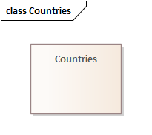
Use of UML classes
We use UML classes to represent sets, e.g., sets of Countries.

Slide 59
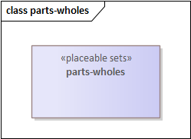
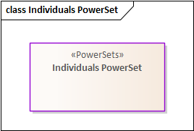
Use of UML classes
Sometimes, sets contain higher-order objects, like tuples.
Stereotype <<placeable sets>> refers to the ontic category of the represented objects,
But we do not expect you to follow this convention in your work study.
Sets may also contain sets.
Stereotype <<PowerSets>> refers to the ontic category of the represented objects,
But we do not expect you to follow this convention in your work study.

Slide 60
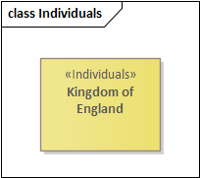
Use of UML classes
Also we use UML classes to represent Individuals.
Stereotype <<Individuals>> shows the ontic category of the represented object,
we do not expect you to follow this convention in your work study.

Slide 61
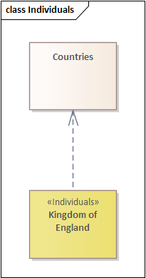
Use of UML dependencies
Countries
Dependency link shows element-sets (tuple).
Kingdom of England

Slide 62
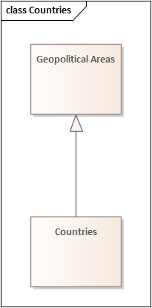
Use of UML generalizations
Geo-political Areas
Countries
Generalization link shows sub-super-sets (tuple).

Slide 63
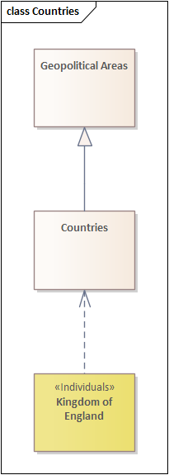
Use of UML dependencies and generalizations
Geo-political Areas
Countries
Kingdom of England

Slide 64
Patterns

Slide 65
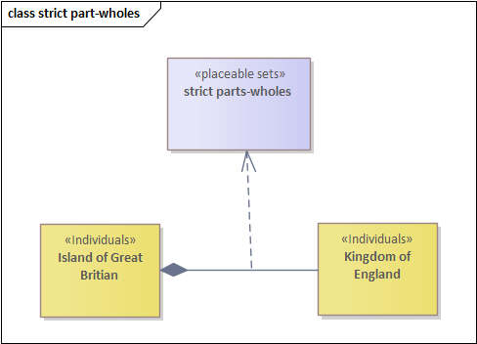
Parts-wholes - basic pattern
strict = proper (excl. identity)
Island of Great Britain
Kingdom of England
UML composition shows part-whole (tuple).
<<place1>> and <<place2>> association stereotypes show,
respectively, the whole and the part.

Slide 66
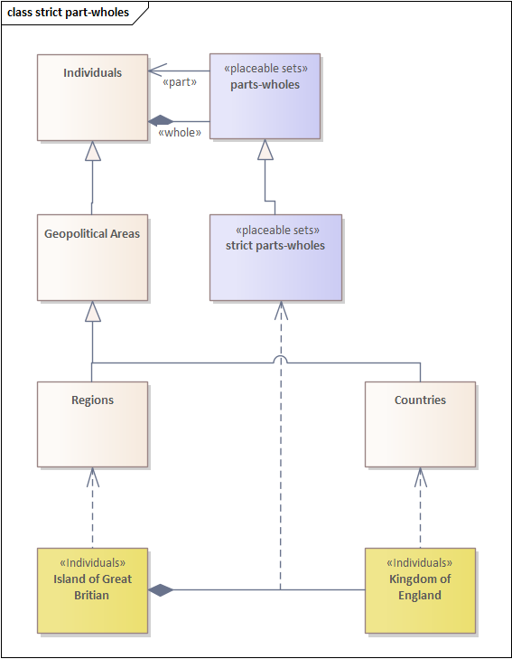
Parts-wholes - full pattern
parts-wholes includes identity tuples,
e.g., <London, London>.
Island of Great Britain
Kingdom of England
strict parts-wholes is a set of tuples, so it can have supersets (and subsets).
<<part>> and <<whole>> association stereotypes show,
respectively, the whole and the part.

Slide 67
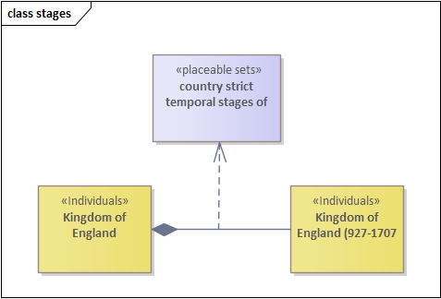
Temporal stages – basic pattern
Kingdom of England
Kingdom of England
(927-1707)
UML composition shows the temporal-stages (tuple).

Slide 68
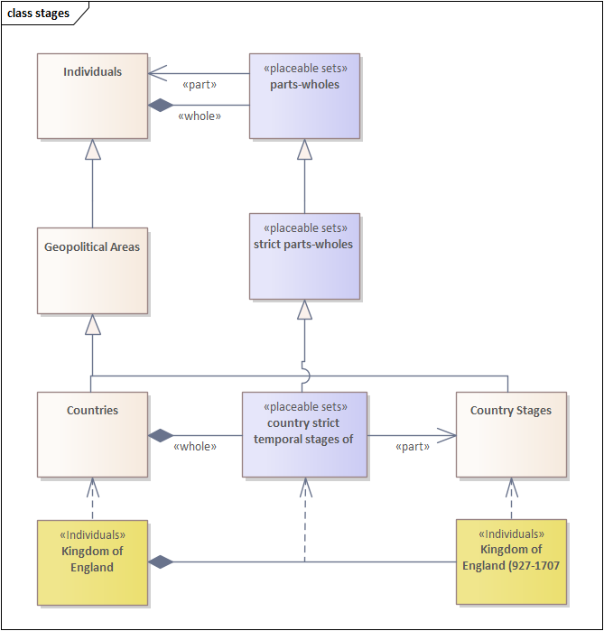
Temporal stages – full pattern
Kingdom of England
Kingdom of England
(927-1707)
country strict temporal stages of
is a set of tuples, so it can have supersets (and subsets)

Slide 69
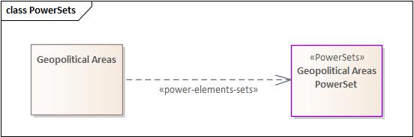
Powerset pattern
set of
all subsets of
set of
geopolitical
areas
set of
geopolitical
areas
dependency stereotype shows the set and its powerset

Slide 70
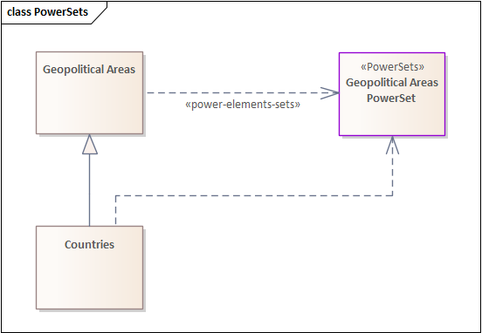
Powerset pattern – implicit tuples
Dependency shows implicit element-set (tuple).

Slide 71
BORO eXcel Table (Manual) Pipeline

Slide 72
Practical problem process
LOAD
EVOLVE
SDT
TOP BUML
STM
OED
BUML
BXTP

Slide 73
Micro transformation pipeline architecture
Define by contrast
not a single monolithic structure
for example, a single complex transformation between two schemas
Pipeline consists of a network of simple micro transformations
the micro transformations are:
algorithmic – they can be coded
simple to allow for maximal inspectability
are repeatable
aim to be reusable
there is an ‘art’ to finding high levels of reusability

Slide 74
‘Formal’ transformation patterns
Repeatable, reusable ‘formal’ patterns
can use same computer code
with enough work

Slide 75
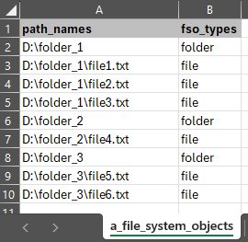
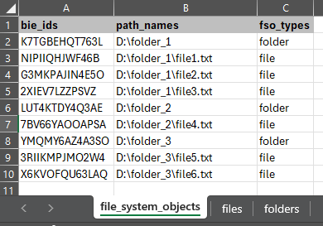
LOAD – bie-ise identifier pattern
A column is added to the beginning of the table
Its name is ‘bie_ids’
The cells uniquely identify the row of the table
No changes are made to the other columns

Slide 76
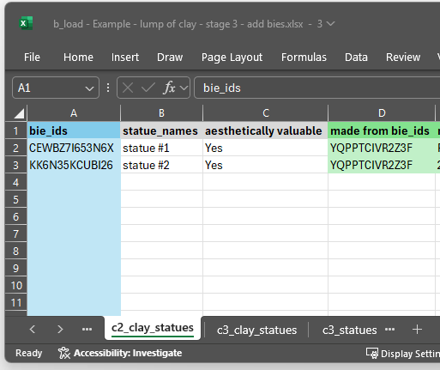
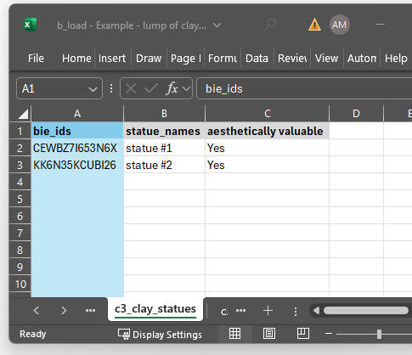
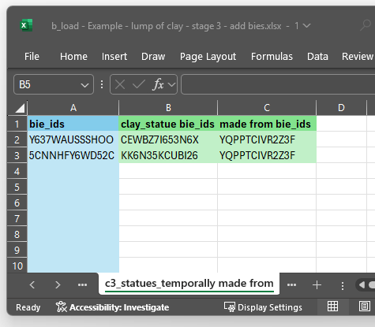
Column split pattern
Note: the identifying bie_ids column is ‘inherited’ by both split tables.
The pattern of inheritance can be of two types.
Identifier preserving
Identifier introducing.
This is driven by the intuition of the intended identity.

Slide 77
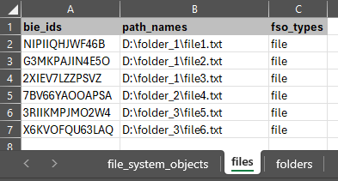
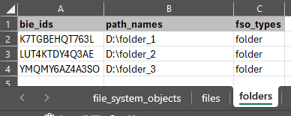
Row split pattern
Typically:
The column heading row is in ALL output tables.
The output tables all have the same format
All rows are in one or other of the split tables.

Slide 78
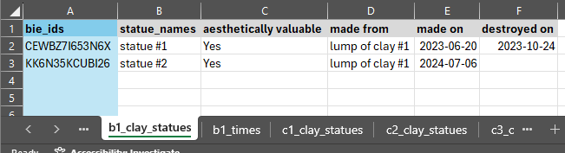
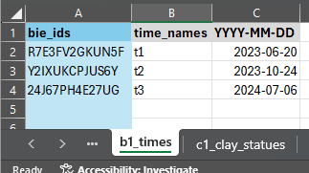
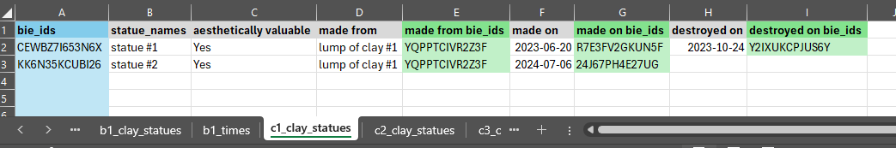
Implicit foreign key bie-ise pattern – stage 1 – add bie_ids
Match the value in the Foreign table
Some columns will be foreign keys
This needs to be made explicit
Add bie id to new column

Slide 79
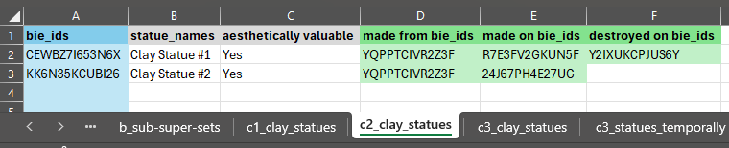
Implicit foreign key bie-ise pattern – stage 2 – remove original columns

Slide 80
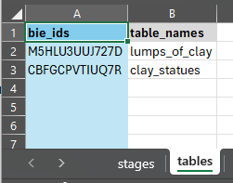
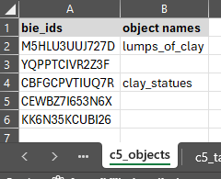
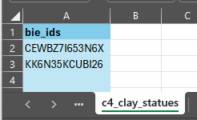
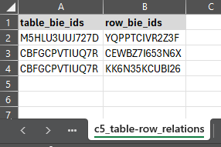
Table-Column heading pushdown pattern
Add table to Objects
Add row to Objects
And add the relations
Tables and column headings can represent objects Useful to have these as rows in the domain.

Slide 81
BORO KNIME Data Pipeline

Slide 82
Practical problem process
LOAD
EVOLVE
primary process
SDT
BKnDP
support tools
BXTP

Slide 83
Goal
To attempt to automatically (using a machine/computer) transform the input into the designed output
acquire a feel for
the constraints upon these kinds of machine pipeline transformations
the nature of these kinds of machine pipeline transformations
To attempt to build reusable micro transformations
acquire a feel for the reuse economics of transformation patterns

Slide 84
BORO KNIME Data Pipeline
The ‘BORO eXcel Table (Manual) Pipeline’ should provide a sufficiently detailed specification of most of the micro transformations
the KNIME is an implementation of the specification
Developing the code to execute the transformation automatically should clarify the formal moves that need to be made

Slide 85
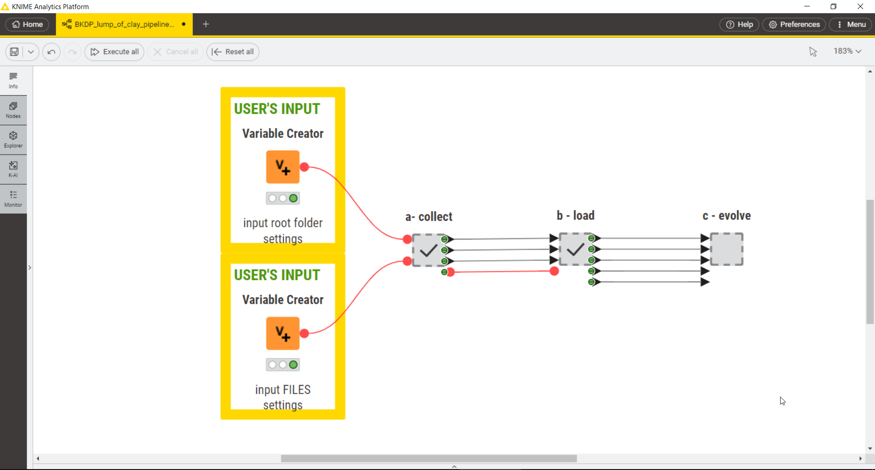
Knime top level – bCLEARer stages

Slide 86
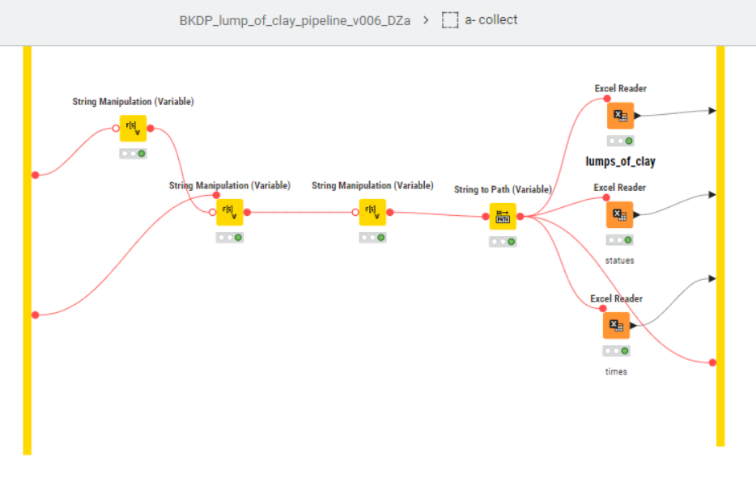
Knime COLLECT – done

Slide 87
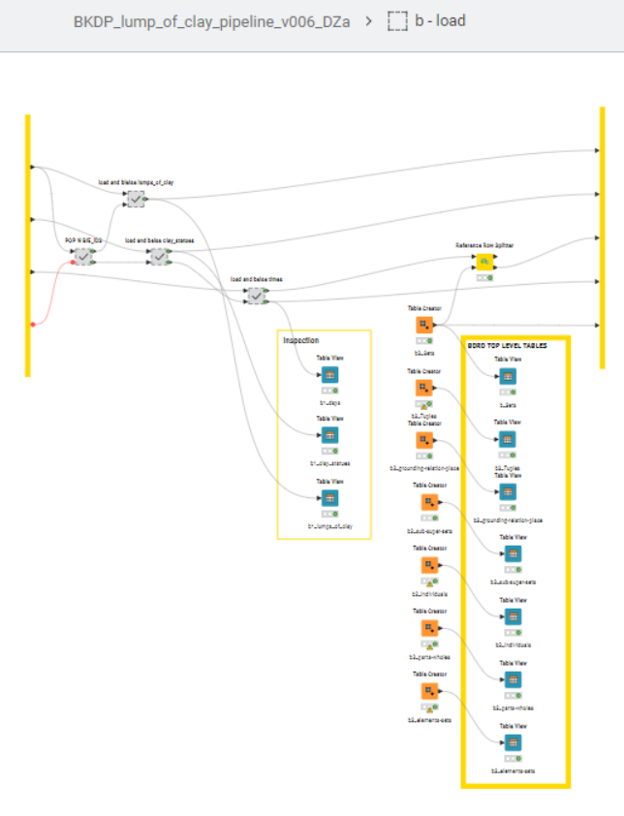
Knime LOAD – done

Slide 88
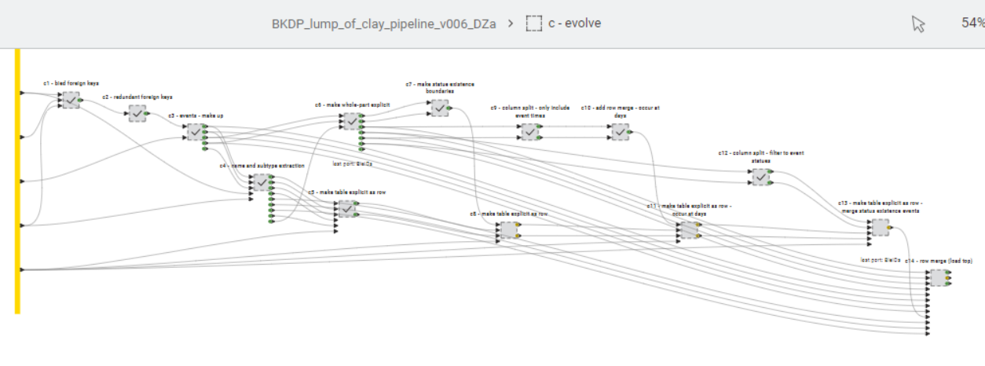
Knime Evolve – work in here

Slide 89
Project planning

Slide 90
Suggested project planning
Remember everything is on GitHub
Suggest you plan your ‘project’
probably better to do a little of each task,
rather than just complete the first few
Task order – earlier tasks feed into later tasks
STM
OED
BUML
BXTP
BKnDP
Try to do at least 1, 2 and 4
if you can, try a little 5 (block out the last half hour to try)
Remember task 5 has starter code

Slide 91

Questions

Slide 92


Slide 93


